Slide 1





SQL Database
for Company Management
Overview of SQL Code for Creating and Managing Company Data
Notes:
1

Slide 2
Team Members
Salma Essam Mohamed Hamad
Gehad Emad Mohamed Mohamed
Mirna Sherief Zayed
Alaa Atef Mustafa
Noureen Ashraf Aboarab
Notes:
2

Slide 3
Introduction
This presentation aims to explain various SQL statements used to create and manipulate a company's database.
Notes:
3

Slide 4
Presentation Outline
Database Creation and Usage
Table Creation & Data Integrity (DDL)
Adding Constraints (DDL)
Data Insertion (DML)
T-SQL Questions
Additional Questions
Notes:
3

Slide 5
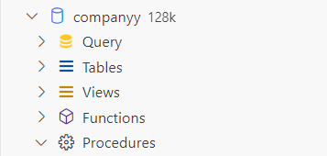
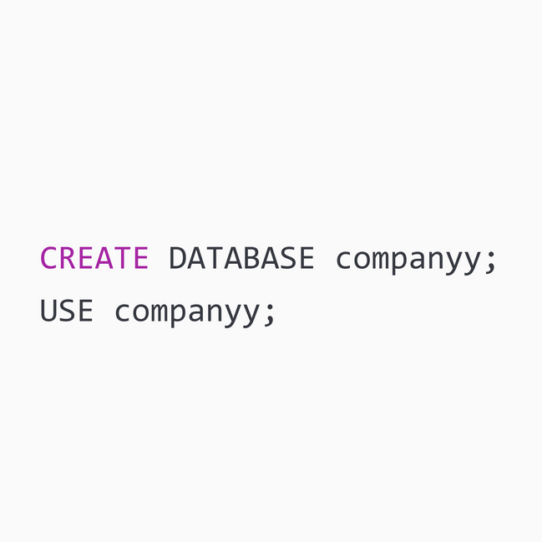

Database Creation and Usage
CREATE DATABASE :
DDL command to create a new database named companyy
USE :
DDL command to select the companyy database for subsequent operations
Notes:
4

Slide 6
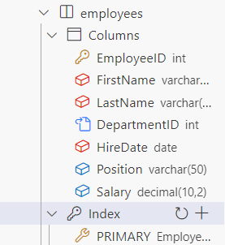
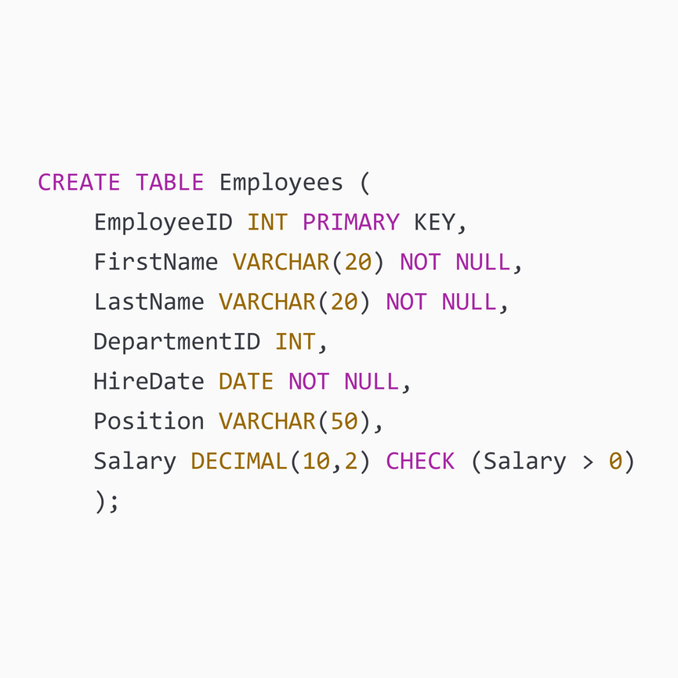
Table Creation & Data Integrity
CREATE TABLE :
This is a Data Definition Language (DDL) command that creates a new table named ‘Employees’
EmployeeID INT PRIMARY KEY :
Defines a column named ‘EmployeeID’ that stores integer values.
The PRIMARY KEY constraint ensures that each ‘EmployeeID’ is unique and not null, uniquely identifying each record in the table.
Notes:
4

Slide 7
Table Creation & Data Integrity
FirstName VARCHAR(20) NOT NULL :
Defines a column named ‘FirstName’ that stores variable-length character strings with a maximum length of 20 characters.
The NOT NULL constraint ensures that the ‘FirstName’ field cannot be left empty.
DepartmentID INT :
This column will be used to reference the department to which the employee belongs.
Notes:
4

Slide 8
Table Creation & Data Integrity
HireDate DATE NOT NULL :
Defines a column named ‘HireDate’ that stores date values.
Salary DECIMAL(10,2) CHECK (Salary > 0) :
Defines a column named Salary that stores decimal values with up to 10 digits in total and 2 digits after the decimal point.
The CHECK (Salary > 0) constraint ensures that the salary must be a positive number.
Notes:
4

Slide 9
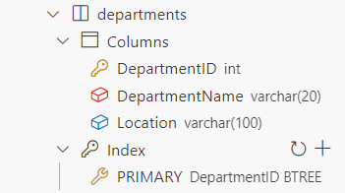
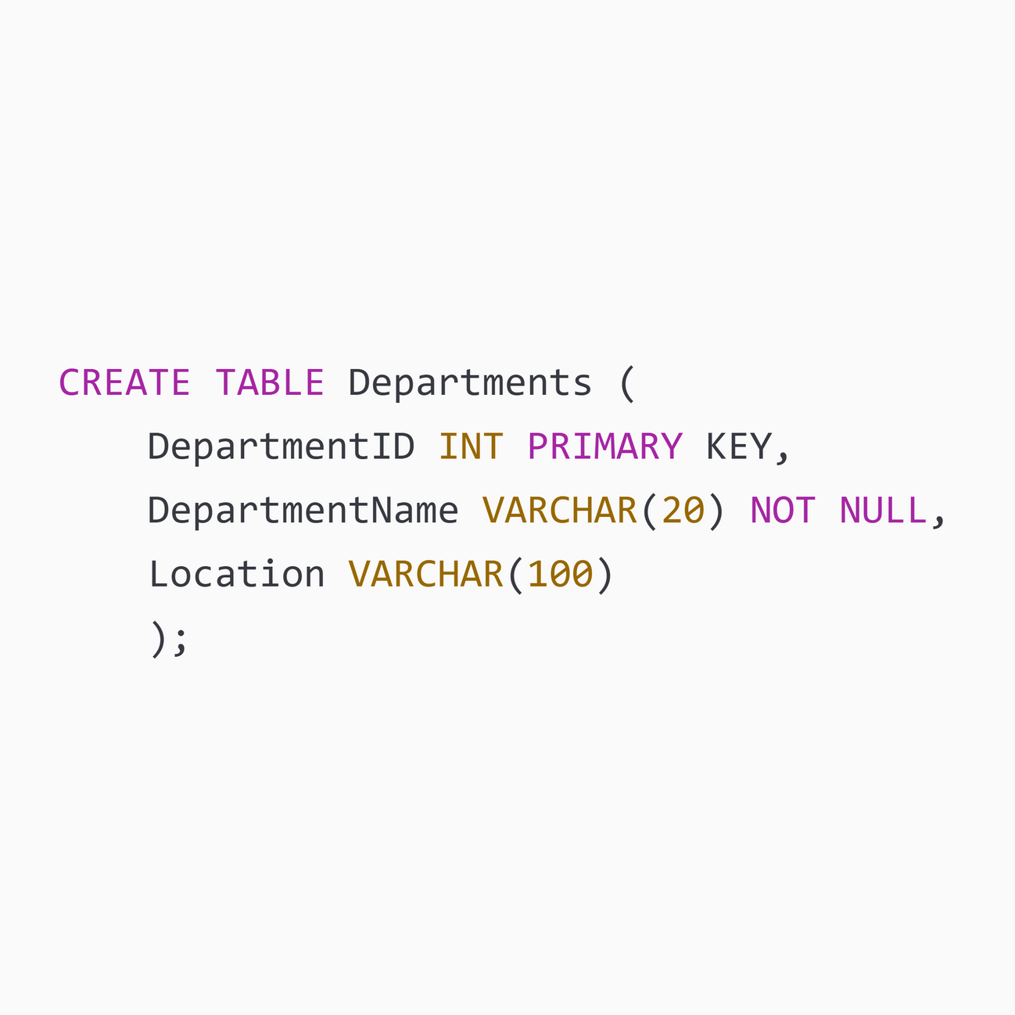
Table Creation & Data Integrity
Notes:
4

Slide 10
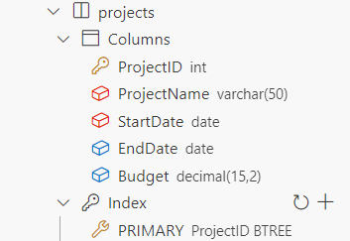
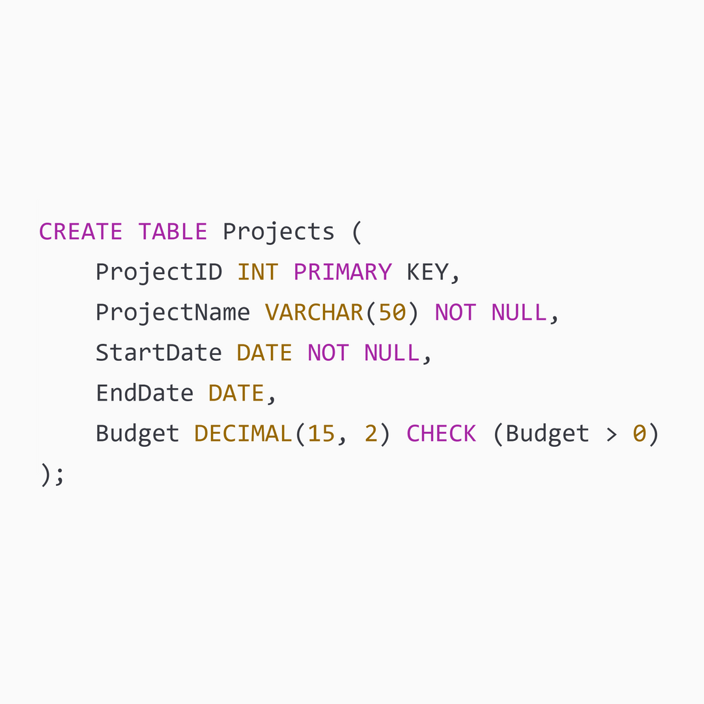
Table Creation & Data Integrity
Notes:
4

Slide 11
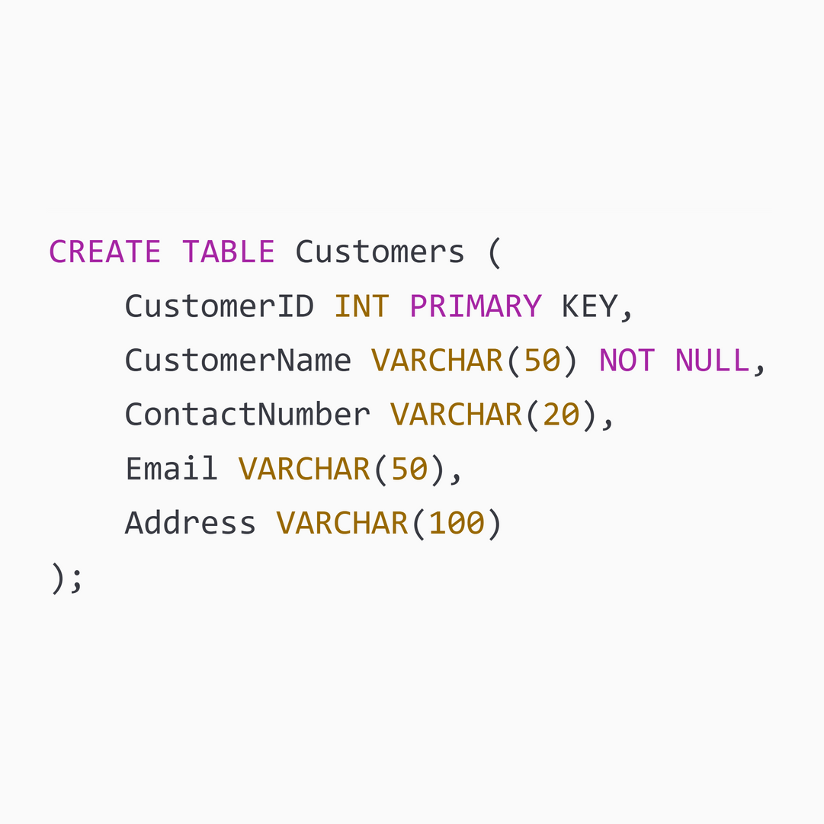
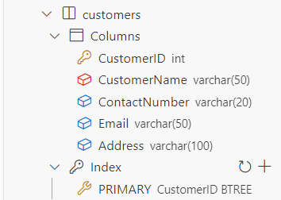
Table Creation & Data Integrity
Notes:
4

Slide 12
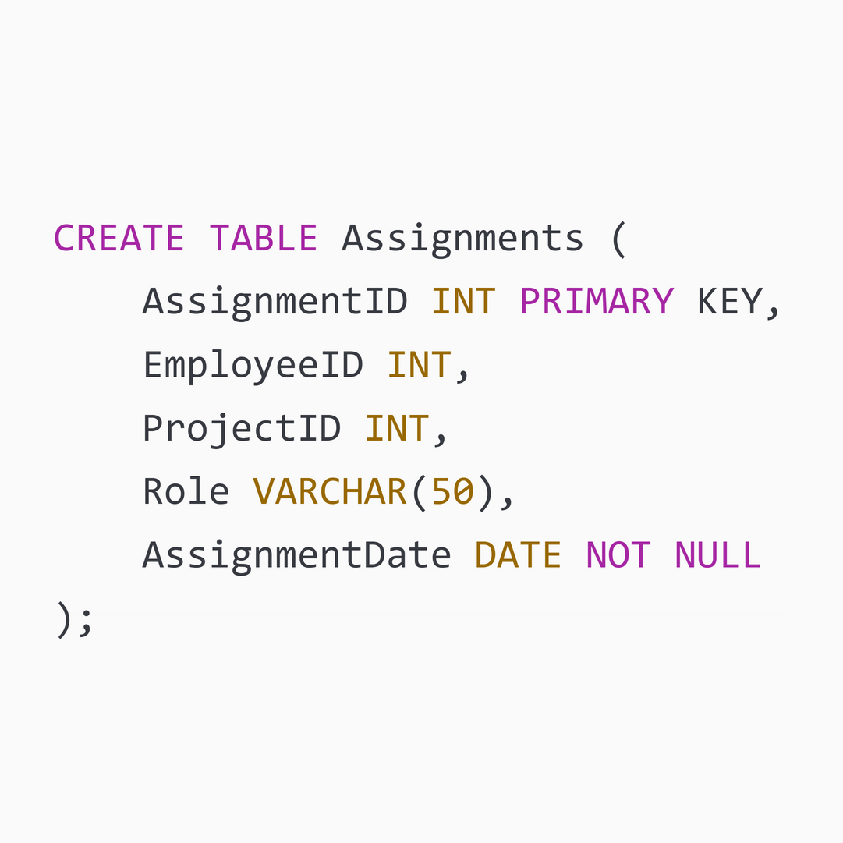
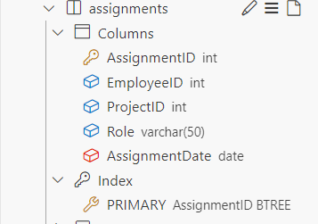
Table Creation & Data Integrity
Notes:
4

Slide 13
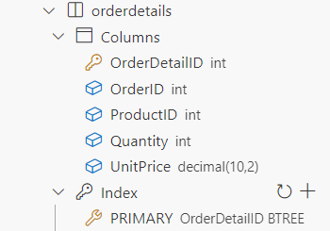
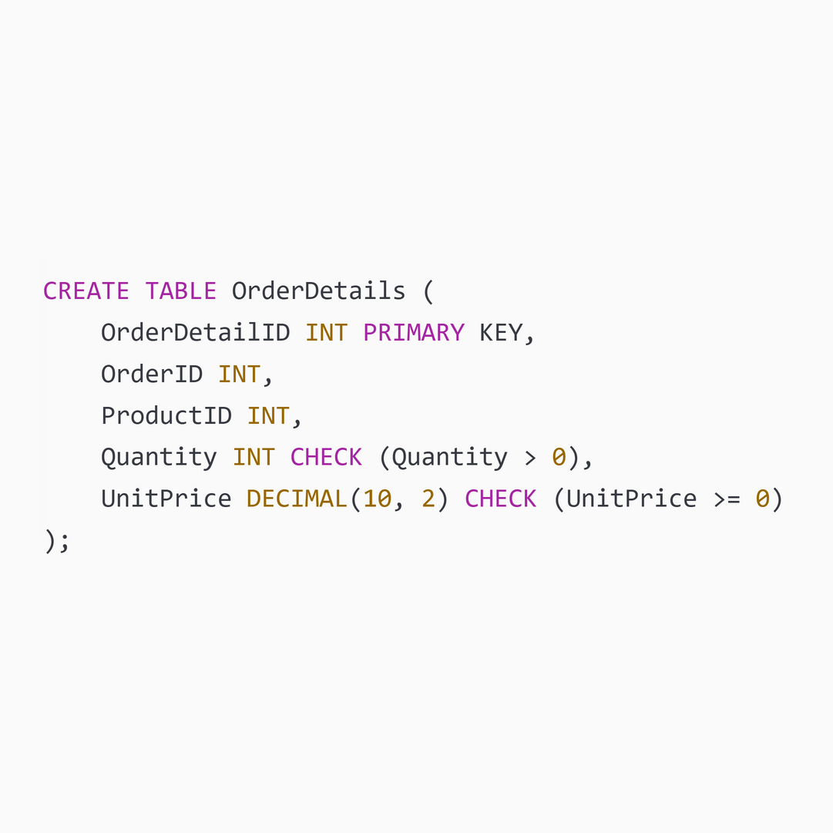
Table Creation & Data Integrity
Notes:
4

Slide 14
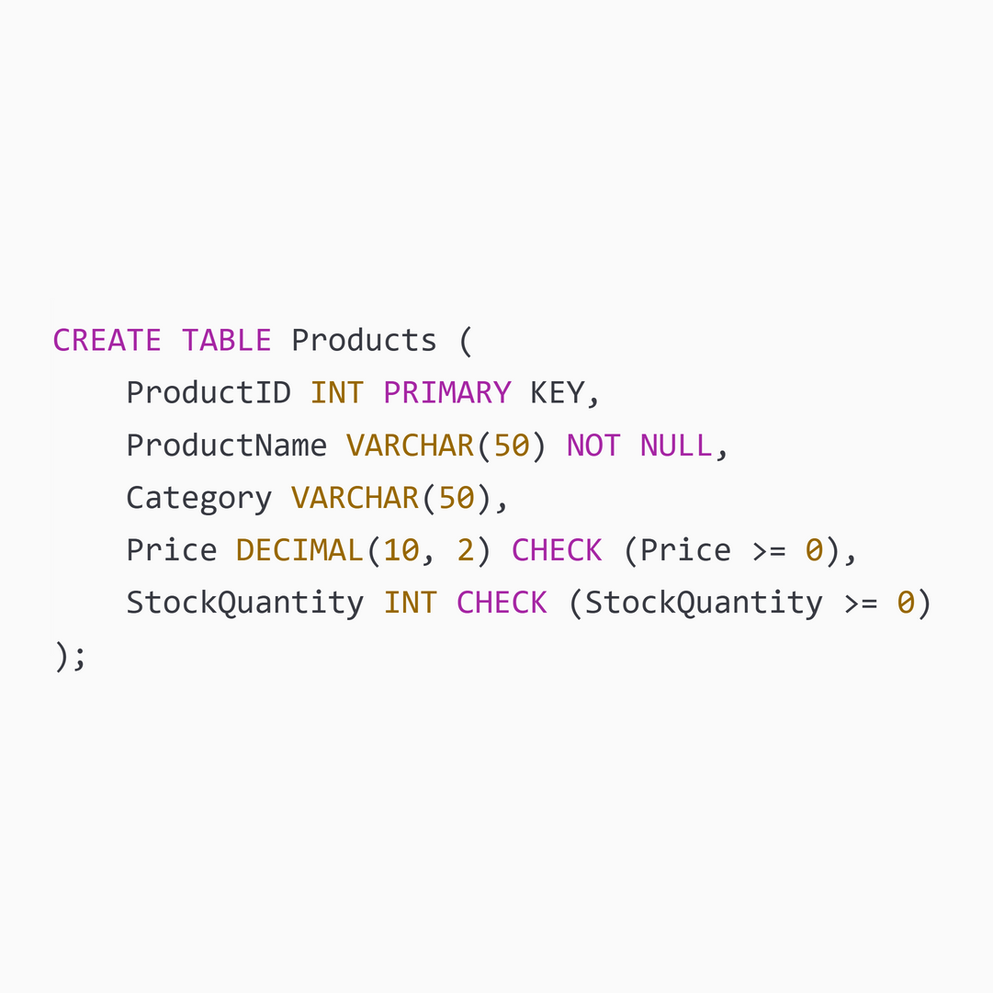
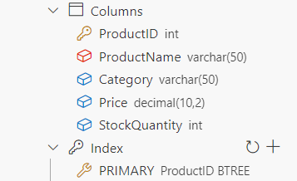
Table Creation & Data Integrity
Notes:
4

Slide 15
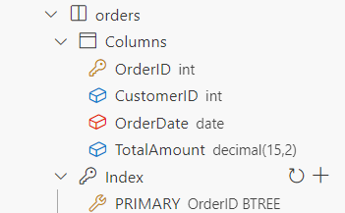
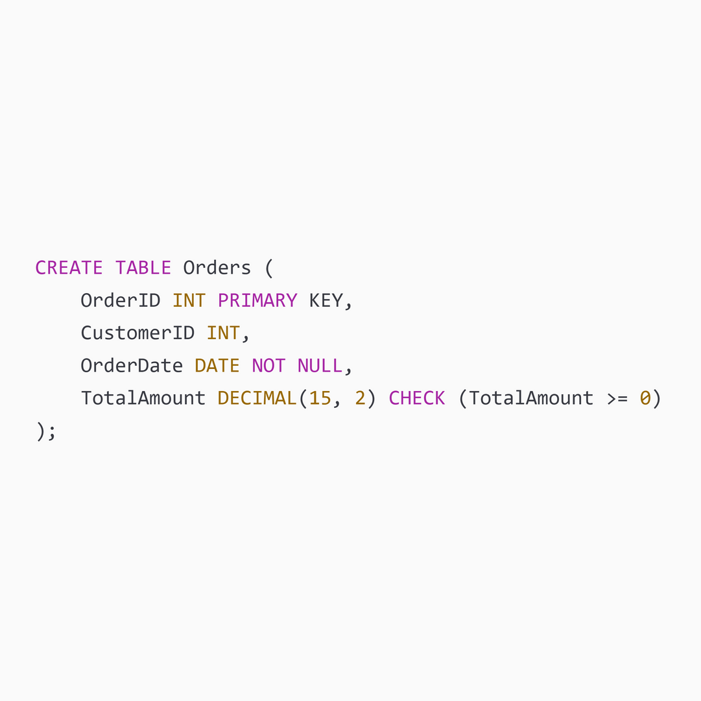
Table Creation & Data Integrity
Notes:
4

Slide 16
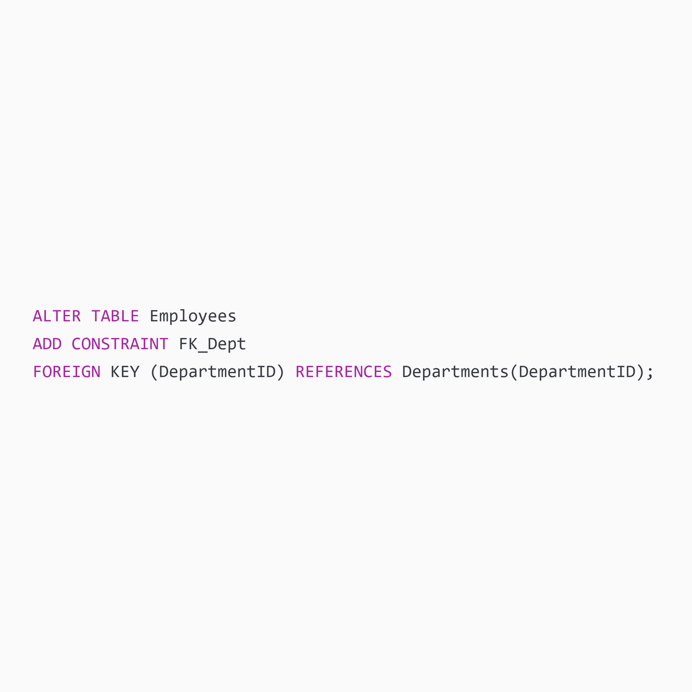
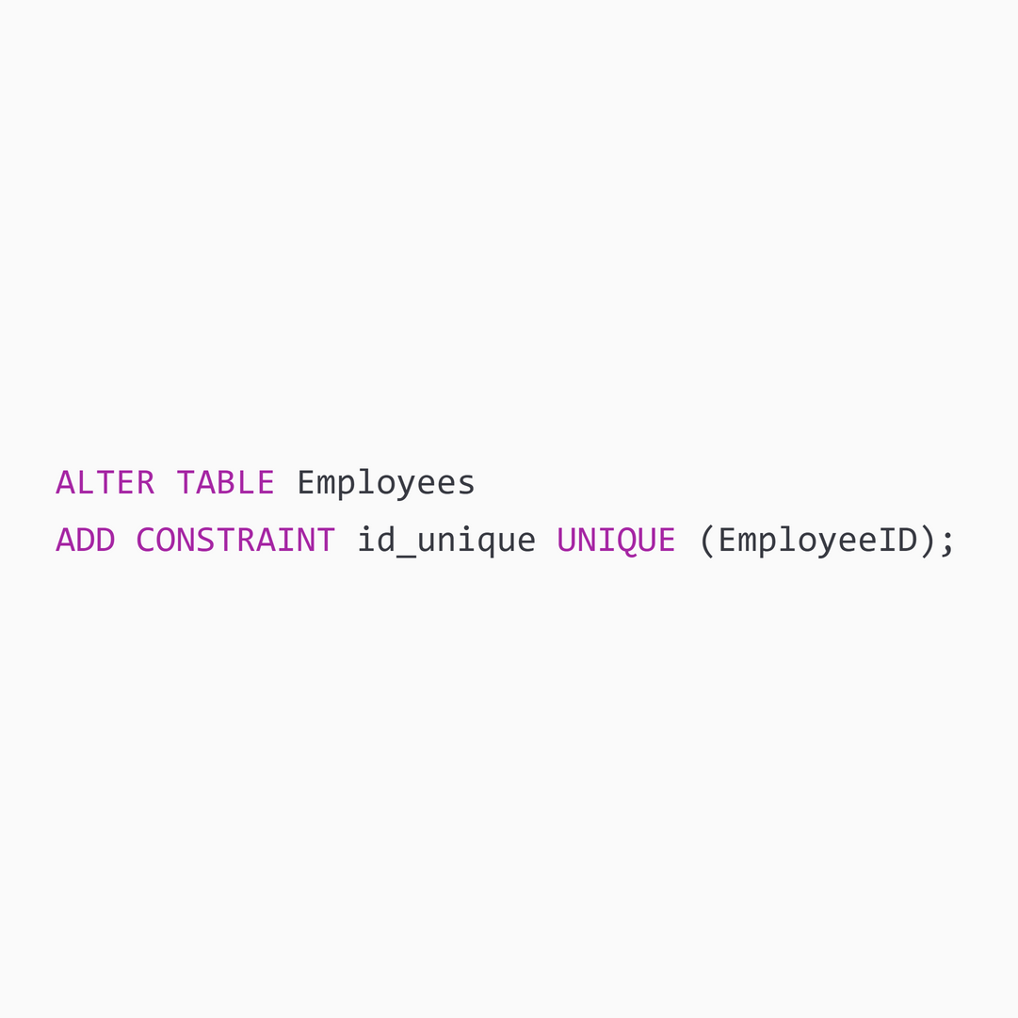
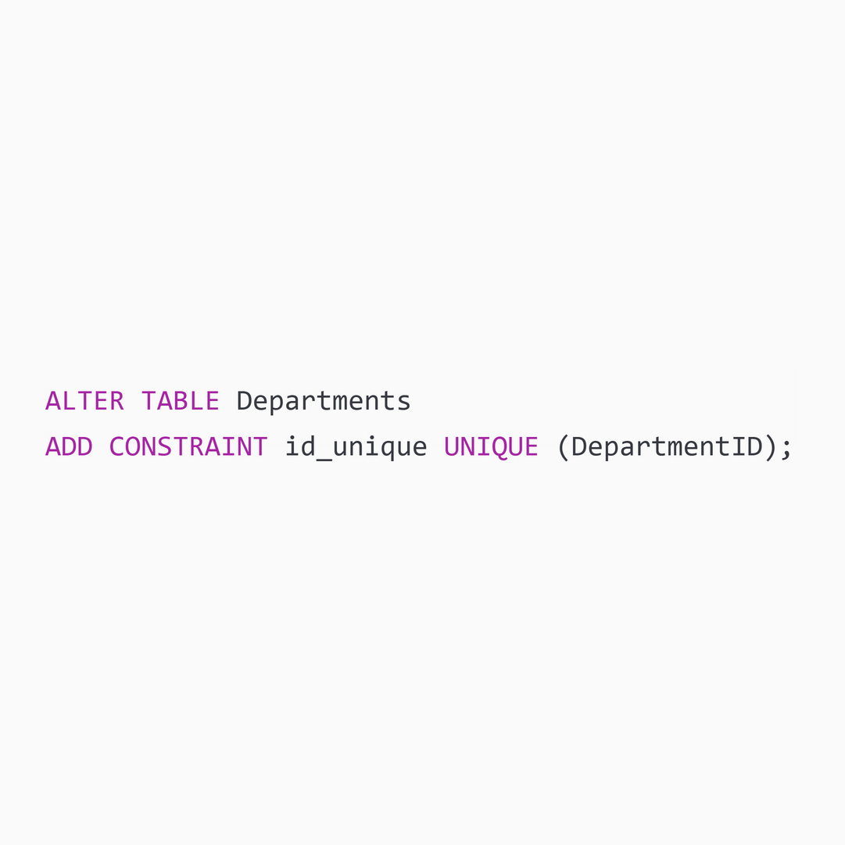
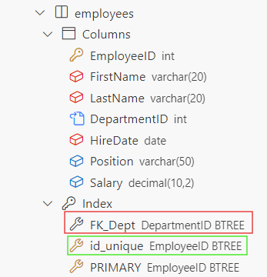
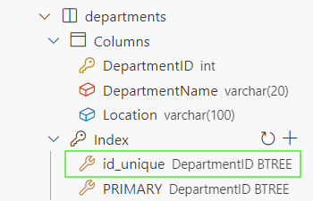
Adding Constraints
ALTER TABLE Employees :
This is a Data Definition Language (DDL) command used to modify the structure of the existing ‘Employees’ table.
ADD CONSTRAINT FK_Dept ( or id_unique):
ADD CONSTRAINT is used to add a new constraint to the table.
‘FK_Dept’ or id_unique is the name given to the new constraint for identification purposes
FOREIGN KEY (DepartmentID) :
This specifies that the ‘DepartmentID’ column in the Employees table is a foreign key.
Notes:
4

Slide 17
Adding Constraints
REFERENCES Departments
(DepartmentID) :
This indicates that the ‘DepartmentID’ column in the Employees table references the ‘DepartmentID’ column in the Departments table.
This establishes a relationship between the Employees table and the Departments table, ensuring that each DepartmentID in the Employees table matches a valid DepartmentID in the Departments table.
UNIQUE (EmployeeID) :
The UNIQUE constraint ensures that all values in the ‘EmployeeID’ column are unique across the table.
This means that no two rows in the Employees table can have the same ‘EmployeeID’ value.
Notes:
4

Slide 18
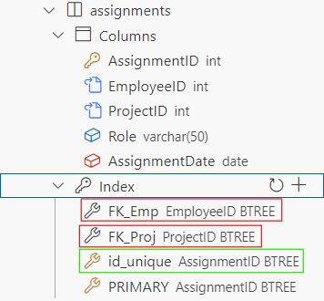
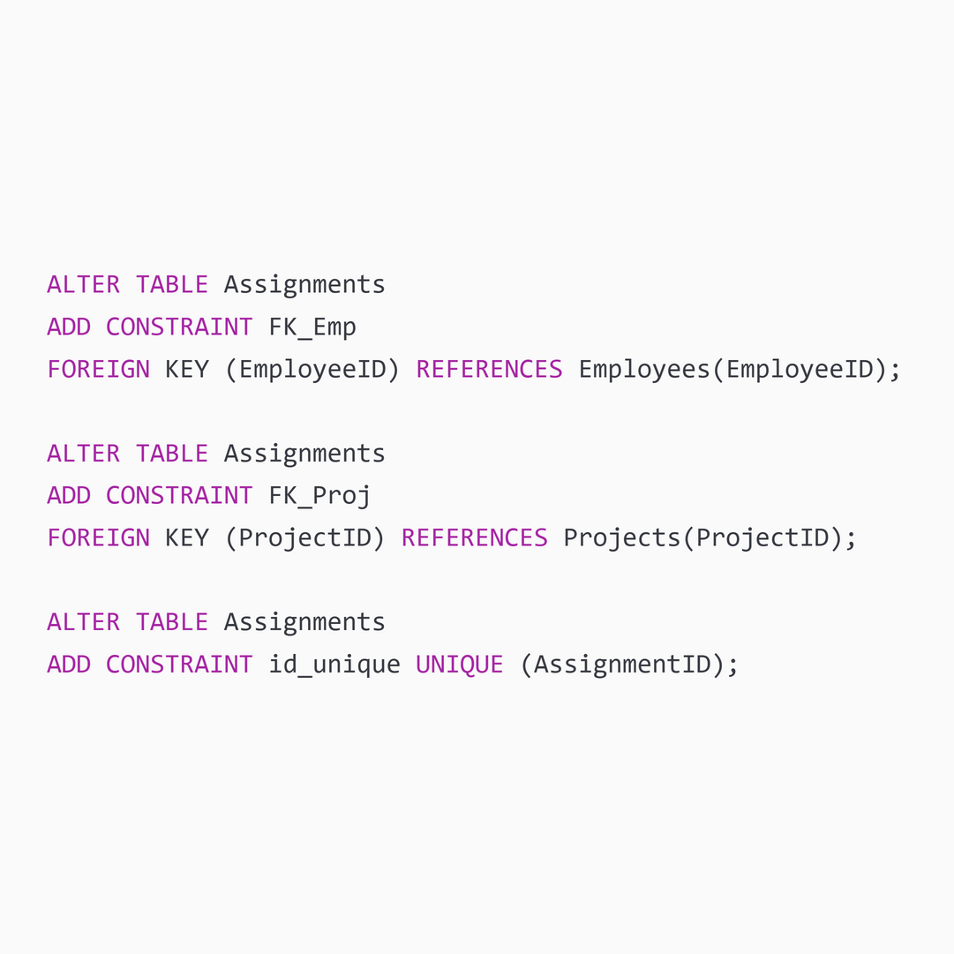
Adding Constraints
Notes:
4

Slide 19
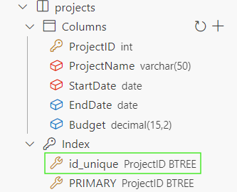

Adding Constraints
Notes:
4

Slide 20
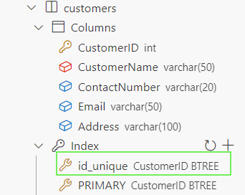

Adding Constraints
Notes:
4

Slide 21
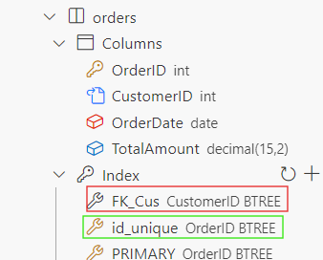
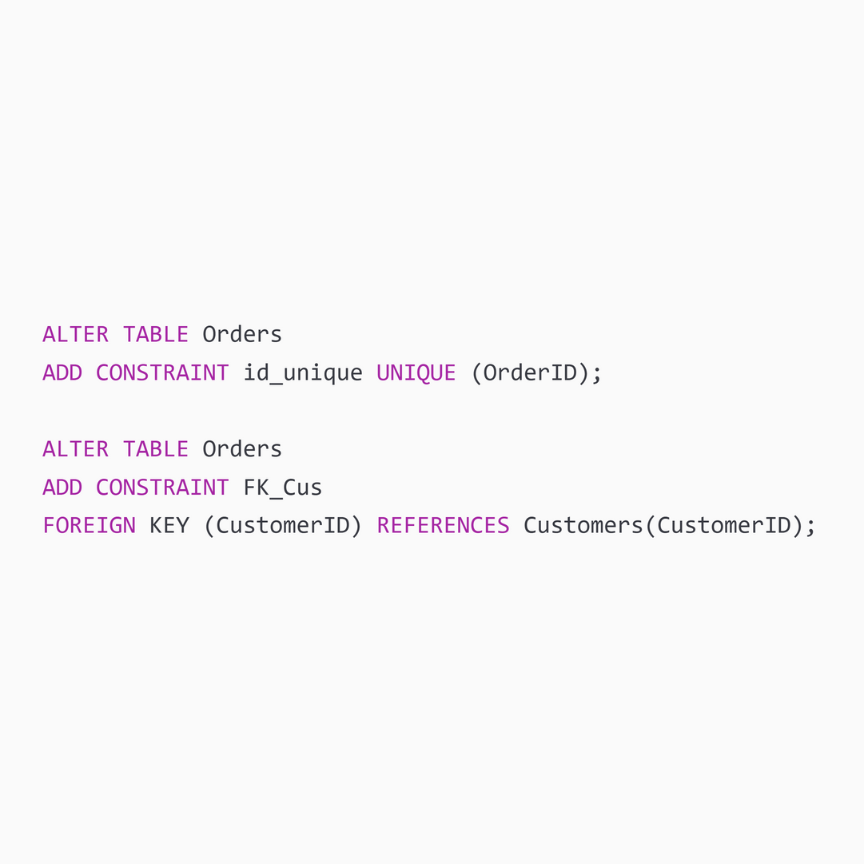
Adding Constraints
Notes:
4

Slide 22
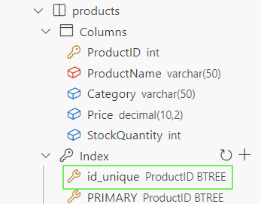

Adding Constraints
Notes:
4

Slide 23
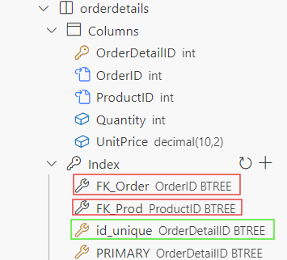
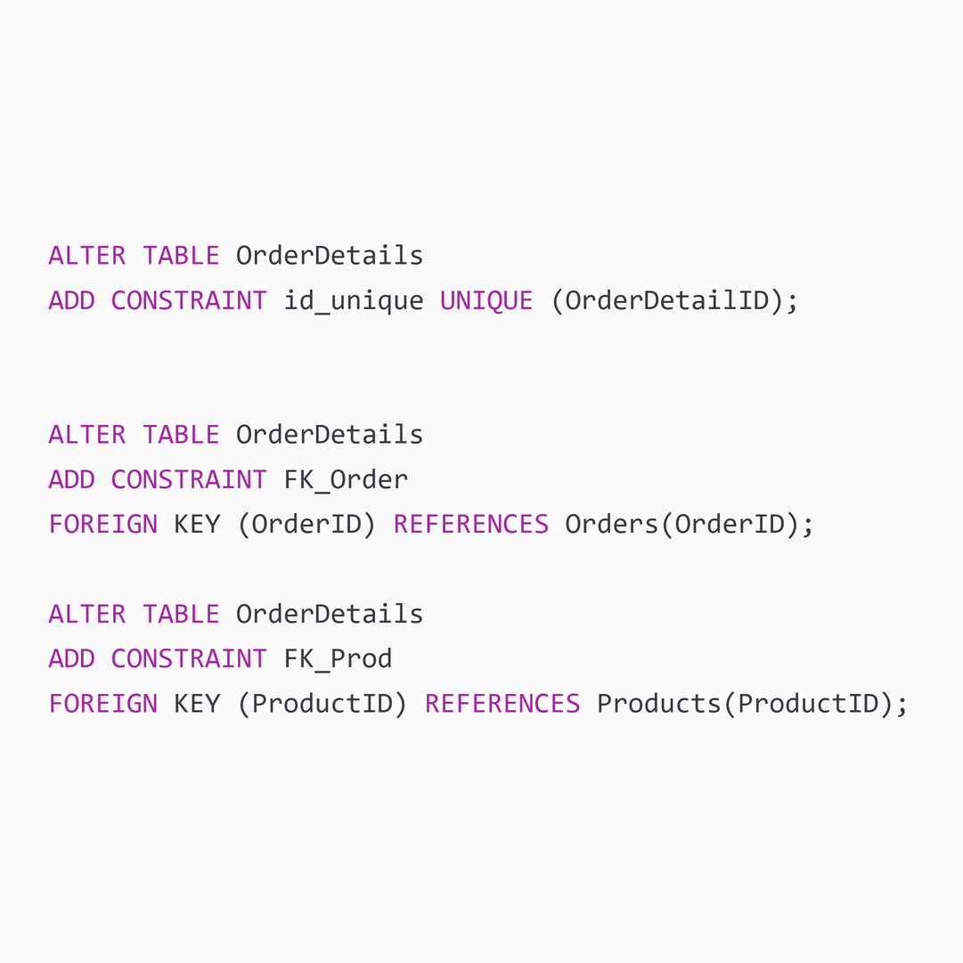
Adding Constraints
Notes:
4

Slide 24
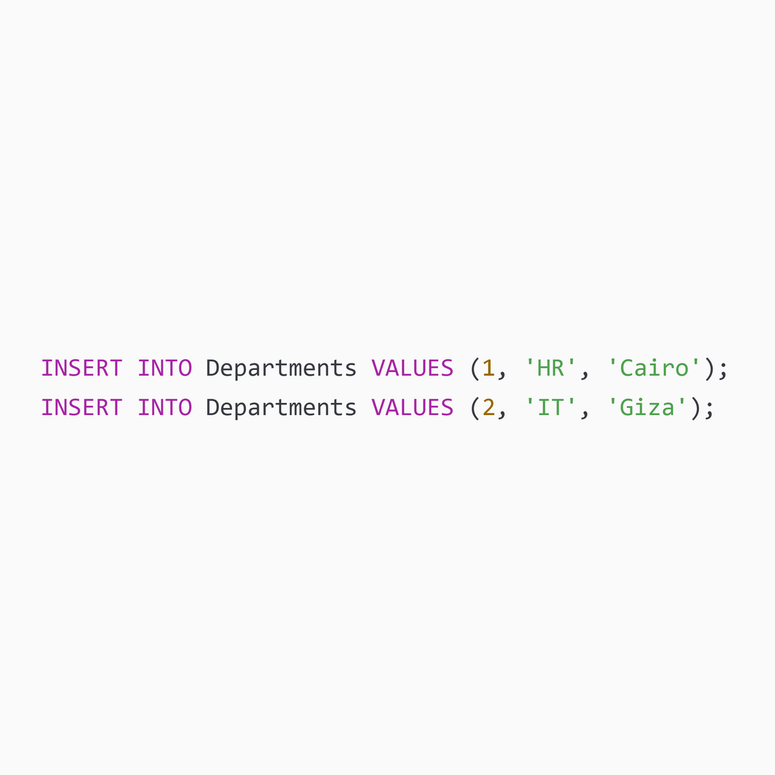
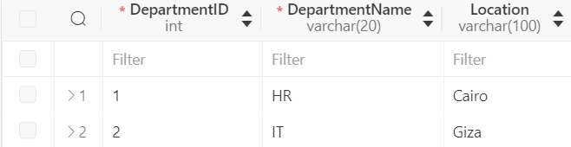
Data Insertion
INSERT INTO :
This is a Data Manipulation Language (DML) command used to add new records to the ‘Department’ table.
VALUES :
This specifies the values to be inserted into the respective columns of the Departments table.
Notes:
4

Slide 25
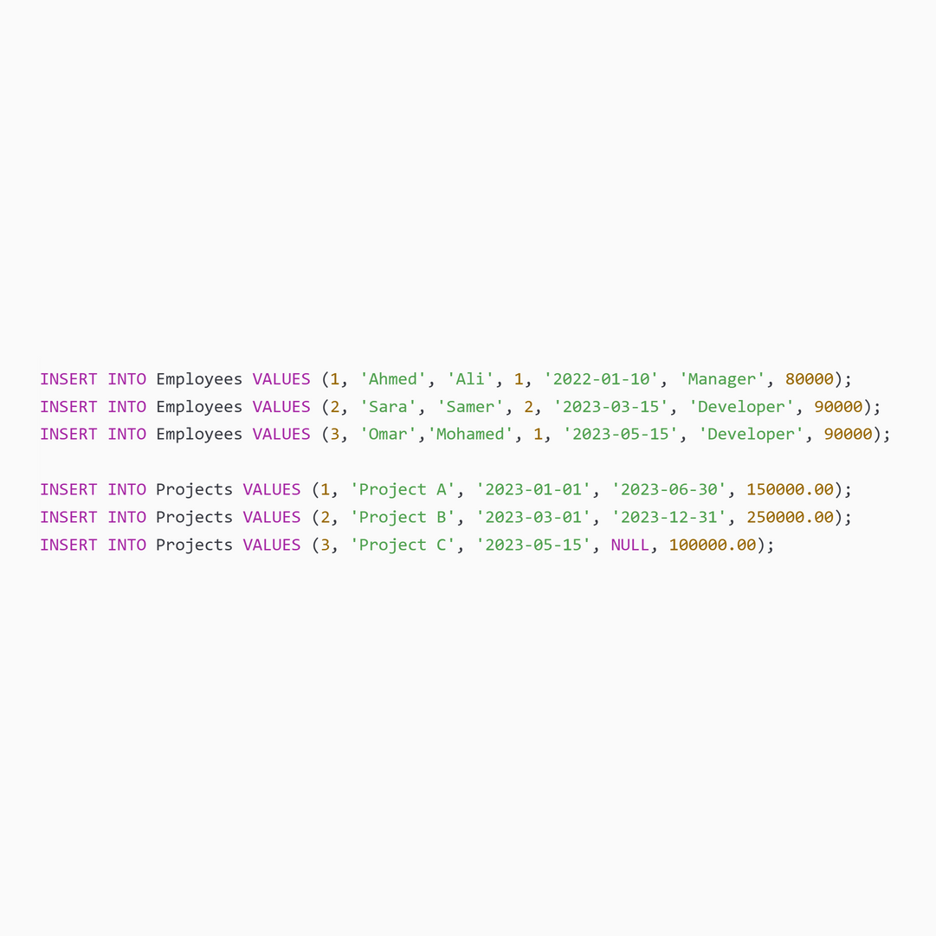
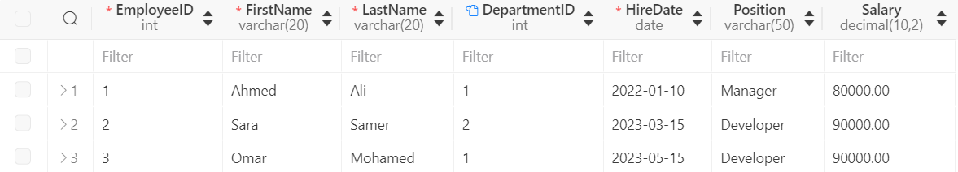
Data Insertion
Notes:
4

Slide 26
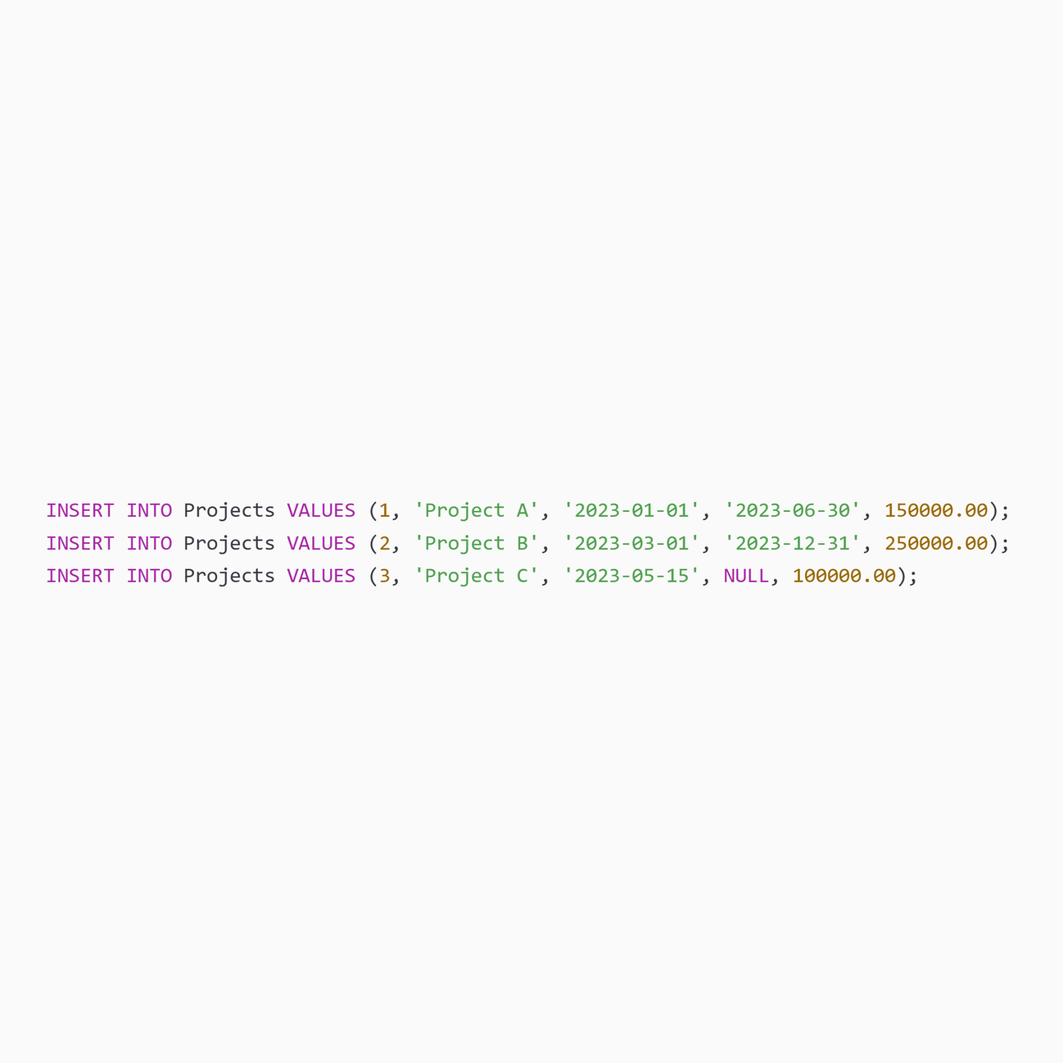
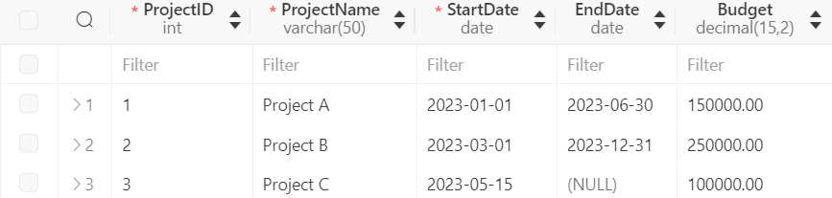
Data Insertion
Notes:
4

Slide 27
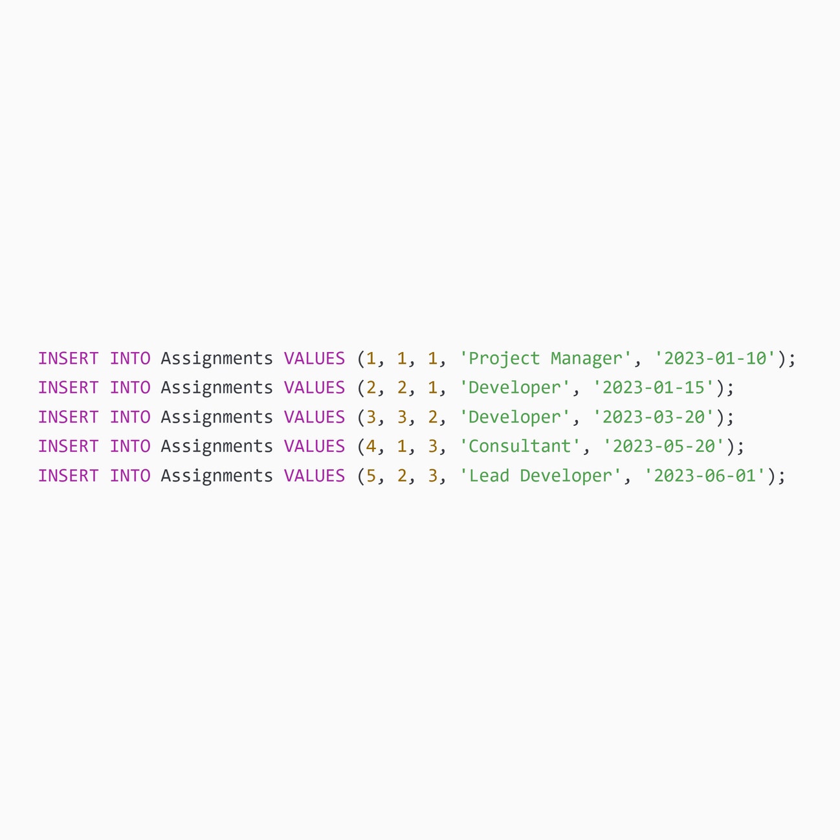
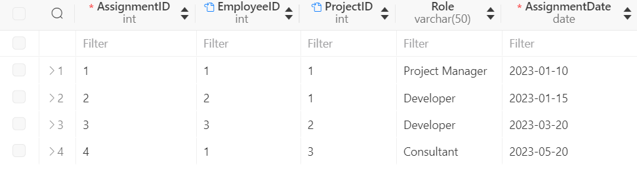
Data Insertion
Notes:
4

Slide 28
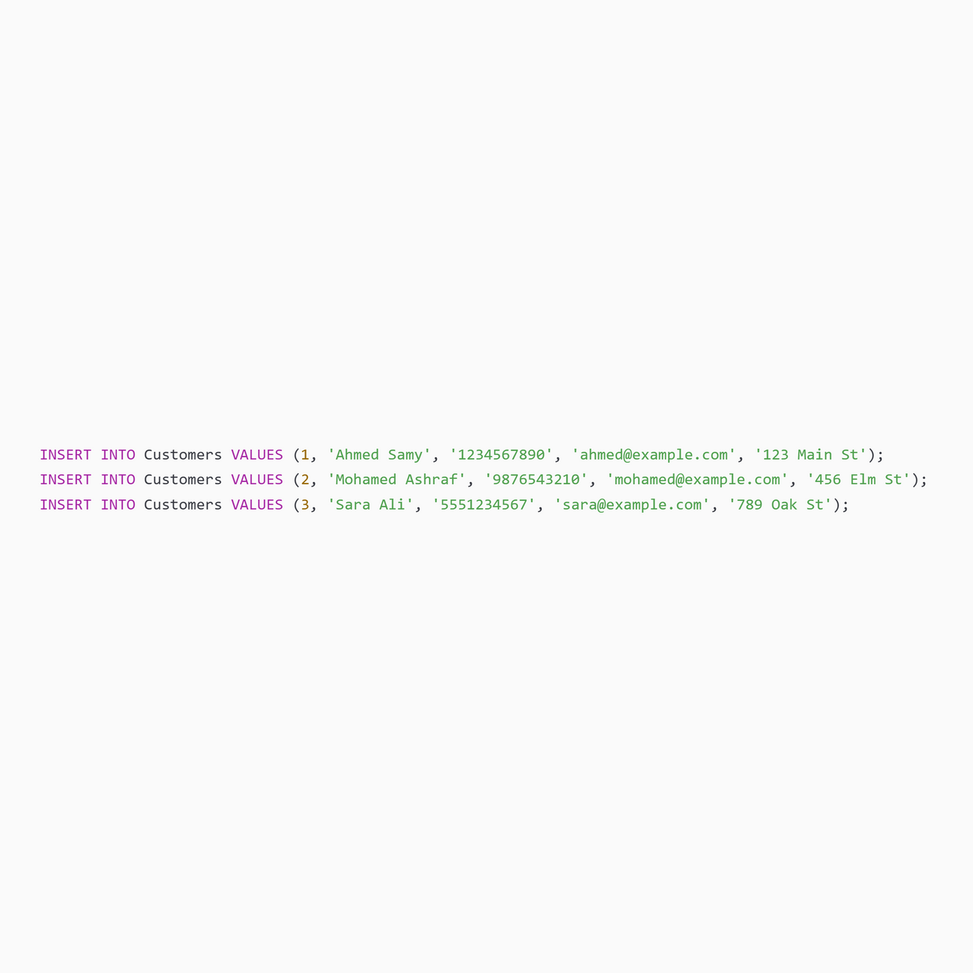
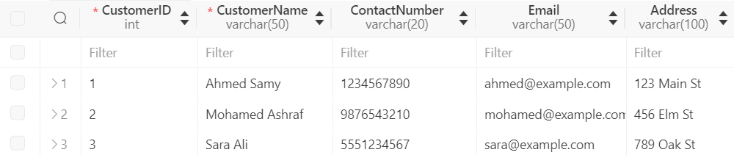
Data Insertion
Notes:
4

Slide 29
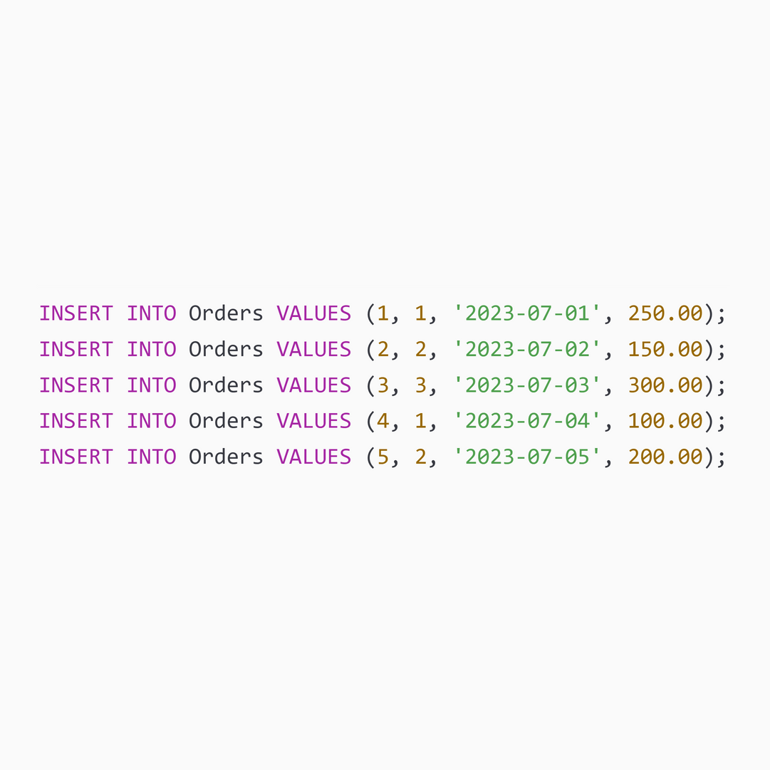
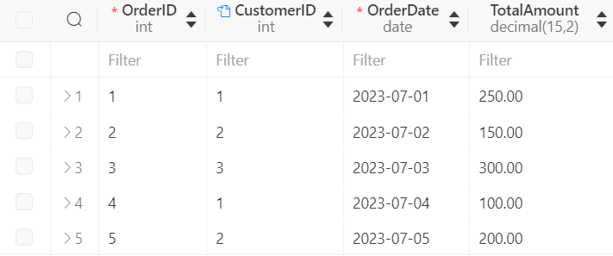
Data Insertion
Notes:
4

Slide 30
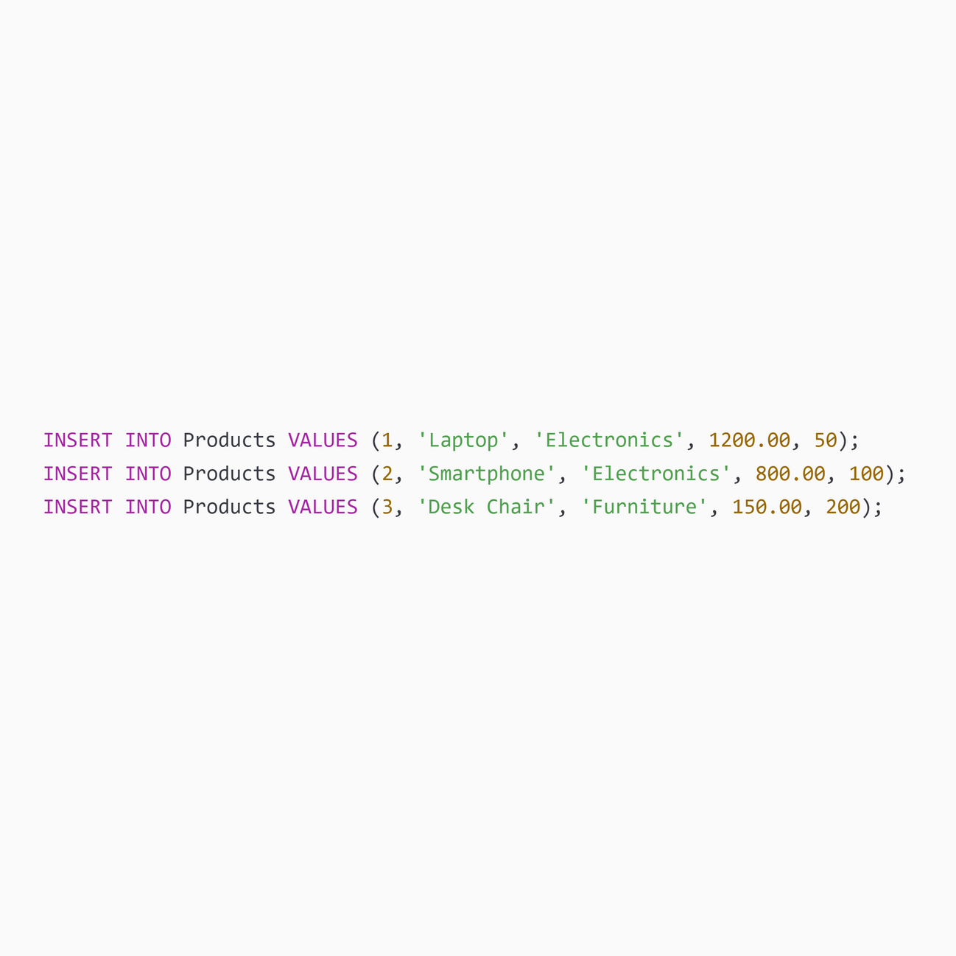
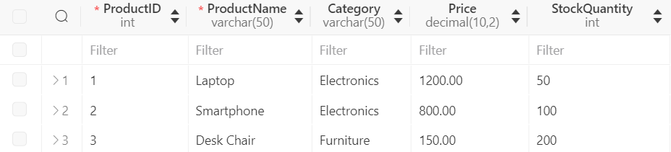
Data Insertion
Notes:
4

Slide 31
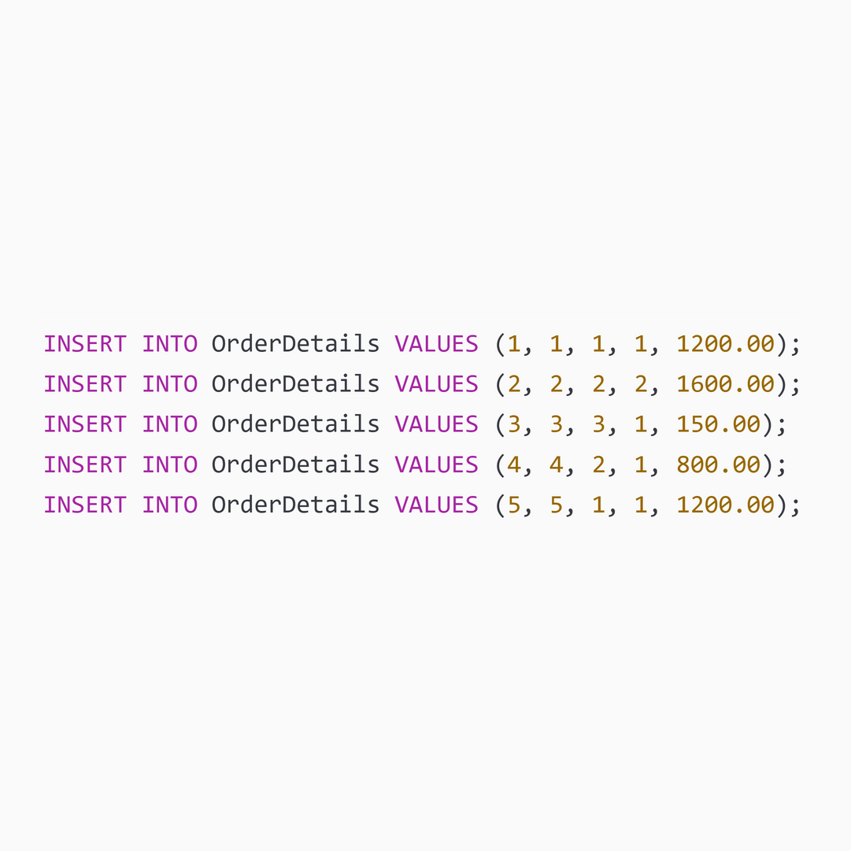
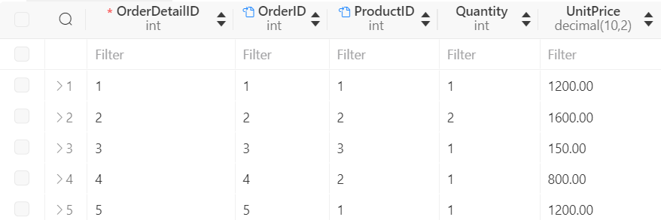
Data Insertion
Notes:
4

Slide 32
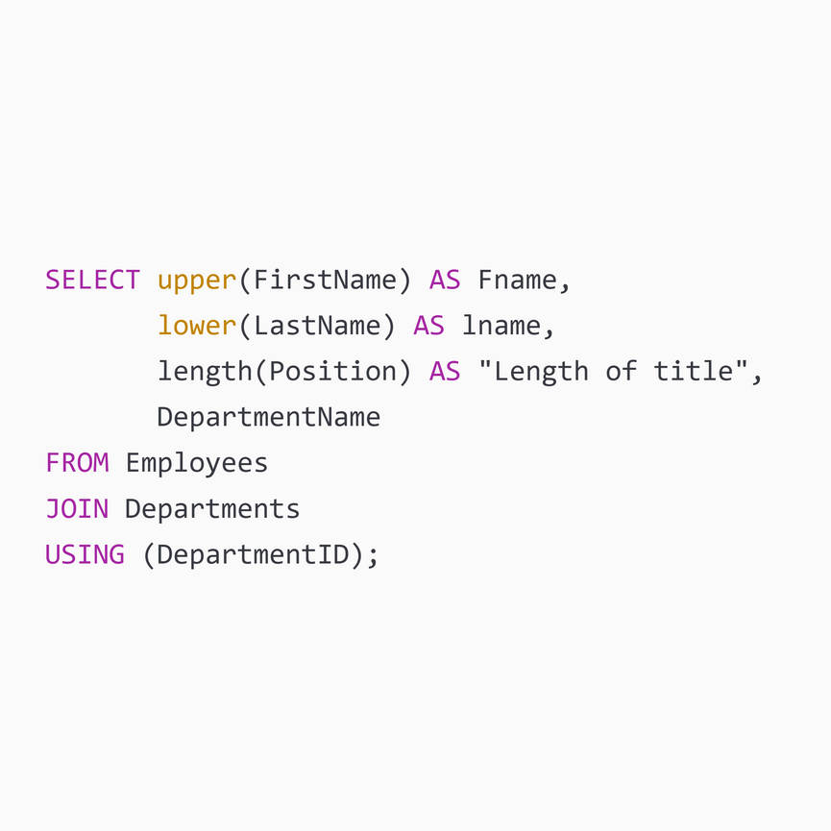
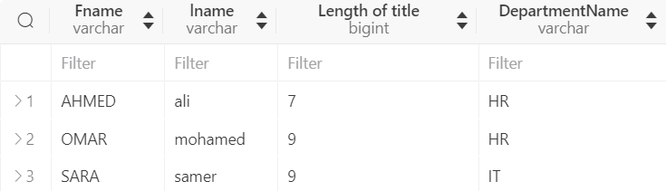
T-SQL Questions
Question 1: Employee Details with Function Manipulation
This SQL statement retrieves and manipulates data from the Employees and Departments tables. It selects the first names of employees in uppercase, the last names in lowercase, the length of the job position titles, and the department names. The JOIN operation ensures that only employees with valid department IDs (i.e., those that exist in the Departments table) are included in the result set.
Notes:
4

Slide 33


T-SQL Questions
Question 2: Department Budget Summary
This SQL statement retrieves and aggregates data from the Employees and Departments tables to generate a budget summary for each department. It counts the number of employees in each department and calculates the total salary expenditure, rounded to the nearest integer. The JOIN operation links employees to their respective departments, and the GROUP BY clause ensures that the summary is grouped by department. This provides a clear overview of the number of employees and the salary costs for each department.
Notes:
4

Slide 34


T-SQL Questions
Question 3: Project Assign
This SQL statement retrieves and formats data from the Assignments, Projects, and Employees tables to provide information about project assignments. It selects the project names in uppercase, concatenates the first and last names of employees to form full names, and includes the role of each employee in the project. The JOIN operations link assignments to their respective projects and employees, ensuring that the result set includes relevant information from all three tables. This helps in generating a detailed report of who is assigned to which project and their respective roles.
Notes:
4

Slide 35


T-SQL Questions
Question 4: Customer Order Analysis
This SQL statement retrieves and aggregates data from the Orders and Customers tables to provide an analysis of customer orders. It selects the customer names in lowercase, counts the number of orders placed by each customer, and calculates the total amount spent by each customer. The JOIN operation links orders to their respective customers, and the GROUP BY clause ensures that the analysis is grouped by customer. This provides a detailed report of customer order behavior, including the number of orders and total spending for each customer.
Notes:
4

Slide 36


T-SQL Questions
Question 5: Product Details Extraction
This SQL statement retrieves and aggregates data from the Products and OrderDetails tables to provide detailed information about products and their order quantities. It selects the first 10 characters of the product names, extracts the first 2 characters to represent the category, and calculates the total quantity ordered for each product. The JOIN operation links products to their respective order details, and the GROUP BY clause ensures that the extraction and aggregation are grouped by product. This helps in generating a detailed report of product details and their total quantities ordered.
Notes:
4

Slide 37

T-SQL Questions
Question 6: High Salary Employees in Specific Departments
This stored procedure, GetHighSalaryEmployees, identifies employees who earn higher salaries than the average salary within their respective departments. It retrieves the full name of these employees, their salary, and the department name. A subquery is used to calculate the average salary for each department, and JOIN operations link this information to the main query. The WHERE clause filters the results to include only employees with salaries above the departmental average.
Notes:
4

Slide 38


Additional Question
use sub-query to get Avg(count salary ):
Notes:
4

Slide 39



Additional Question
Function to check the avg(salary), control flow to print when salary greater than the avg salary "Higher than" else "Lower than" :
Notes:
4

Slide 40

Additional Question
Delete from project table when department name called "IT" :
Notes:
4

Slide 41


Additional Question
Get all Employee name have been working in IT department :
Notes:
4

Slide 42




Introduction to SQL
What is SQL?
Essential for Data-Driven Businesses
Powerful Data Management
SQL, or Structured Query Language, is a powerful programming language used to manage and manipulate relational databases.
SQL's versatility enables users to efficiently manage and analyze large datasets, powering data-driven decision making.
SQL allows users to create, read, update, and delete data with ease, making it an essential tool for data-driven businesses and organizations.
Notes:
3

Slide 43
SQL Basics
Data Definition
Data Manipulation
Data Control
SQL provides commands to create, modify, and delete database objects such as tables, views, and indexes.
SQL allows users to insert, update, delete, and query data stored in the database.
SQL includes features for managing user access and permissions, ensuring data integrity and security.
Notes:
4

Slide 44




SQL Data Types
Numeric Types
Text Types
Date and Time Types
Boolean Types
SQL supports a variety of numeric data types, including integers, floats, and decimals.
SQL can handle text data, such as strings, characters, and fixed-length text fields.
SQL provides specialized data types for storing and manipulating dates, times, and timestamps.
SQL allows for the storage of true/false or yes/no values.
Notes:
6

Slide 45



SQL Statements
DDL Statements
DML Statements
DCL Statements
Manage the structure of the database by creating, modifying, and removing core database objects.
Interact with the data stored in the database by adding, changing, removing, and retrieving records.
Manage user access and privileges to ensure the security and integrity of the database.
Notes:
7

Slide 46




SQL Queries
Retrieve Data
Filter Results
Sort Data
Group Data
Retrieve data from one or more tables based on specific criteria.
Filter the retrieved data based on conditions specified in the query.
Sort the retrieved data in ascending or descending order.
Group the retrieved data based on one or more columns.
Notes:
8

Slide 47




SQL Joins
INNER JOIN
LEFT JOIN
RIGHT JOIN
FULL JOIN
Combines rows from two or more tables based on a related column.
Returns all rows from the left table and the matching rows from the right table.
Returns all rows from the right table and the matching rows from the left table.
Returns all rows from both tables, regardless of the match.
Notes:
9

Slide 48



SQL Subqueries
Nested Queries
Correlated Subqueries
Scalar Subqueries
SQL subqueries can be nested within other SQL statements, allowing for more complex data retrieval and manipulation.
Subqueries that return a single value, which can be used in the SELECT, WHERE, or HAVING clauses of the outer query.
These subqueries reference a column from the outer query, enabling them to return values based on the context of the outer query.
Notes:
10

Slide 49




Conclusion and Key Takeaways
Versatility
Efficiency
Scalability
Popularity
SQL is a versatile language that can be used to manage and manipulate data in a wide range of applications and industries.
SQL allows for efficient data manipulation and retrieval, helping businesses and organizations make informed decisions based on their data.
SQL-based databases can handle large volumes of data and support the growing needs of modern, data-driven organizations.
SQL is a widely adopted and in-demand skill, making it a valuable addition to any data professional's toolkit.
Notes:
11

